Slide 1
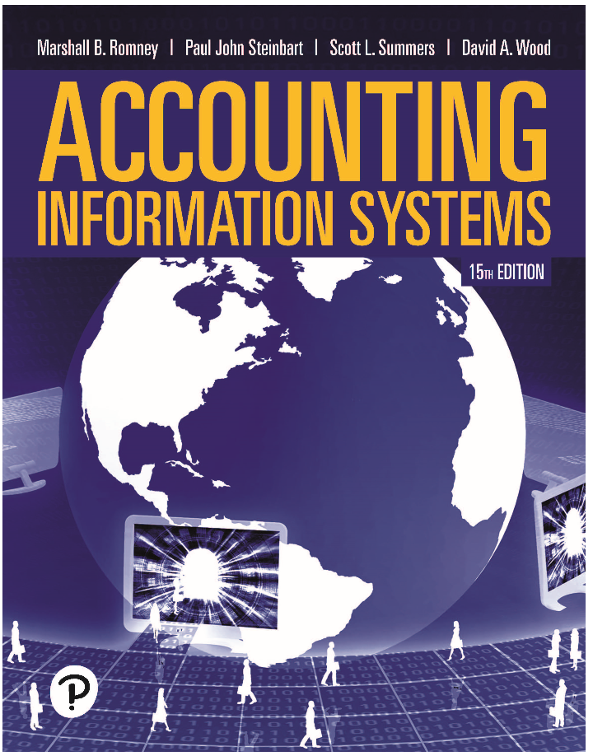
Accounting Information Systems
Fifteenth Edition
Chapter 5
Introduction to Data Analytics in Accounting
Copyright © 2021, 2018, 2015 Pearson Education, Inc. All Rights Reserved
Notes:
If this PowerPoint presentation contains mathematical equations, you may need to check that your computer has the following installed:
1) Math Type Plugin
2) Math Player (free versions available)
3) NVDA Reader (free versions available)

Slide 2
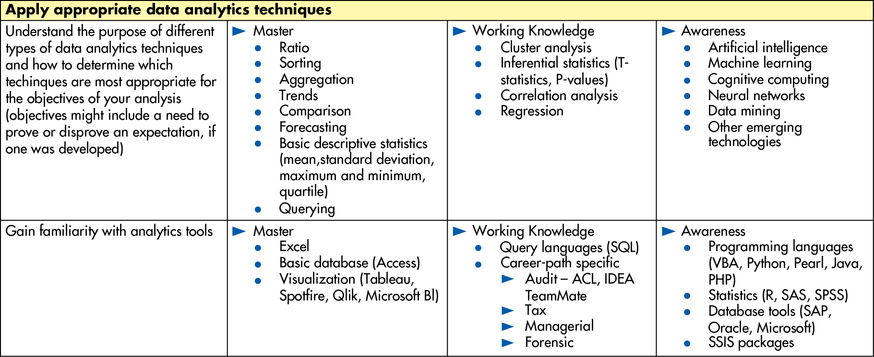
Figure 5.2 Ernst & Young Foundation Recommended Data Analytics Skills
Notes:
Long Description:
The table shows the following information.
Apply appropriate data analytics techniques
Understand the purpose of different types of data analytics techniques and how to determine which techniques are most appropriate for the objectives of your analysis (objectives might include a need to prove or disprove an expectation, if one was developed)
Master
Radio
Sorting
Aggregation
Trends
Comparison
Forecasting
Basic descriptive statistics (mean, standard deviation, maximum and minimum, quartile)
Querying
Working Knowledge
Cluster analysis
Inferential statistics (T-statistics, P-values)
Correlation analysis
Regression
Awareness
Artificial intelligence
Machine learning
Cognitive computing
Neural networks
Data mining
Other emerging technologies
Gain familiarity with analytics tools
Master
Excel
Basic database (Access)
Visualization (Tableau, Spotfire, Qlik, Microsoft B l)
Working Knowledge
Query languages (S Q L)
Career-path specific
Audit – A C L, I D E TeamMate
Tax
Managerial
Forensic
Awareness
Programming languages
(V B A, Python, Pearl, Java, P H P)
Statistics (R, S A S, S P S S)
Database tools (S A P, Oracle, Microsoft)
S S I S packages

Slide 3

Copyright
This work is protected by United States copyright laws and is provided solely for the use of instructors in teaching their courses and assessing student learning. Dissemination or sale of any part of this work (including on the World Wide Web) will destroy the integrity of the work and is not permitted. The work and materials from it should never be made available to students except by instructors using the accompanying text in their classes. All recipients of this work are expected to abide by these restrictions and to honor the intended pedagogical purposes and the needs of other instructors who rely on these materials.

